Slide 1
Understanding your Benefits
A guide explaining what each part of your benefits can do for you!

Slide 2
Knowing the ins and outs of your healthcare plan is your greatest asset!
Having a healthcare plan is so helpful and it can relieve a lot of stress when medical situations arise.
Healthcare benefits can also be confusing and sometimes you may not know exactly how to use each part of your plan.
We are here to give you the knowledge and power to fully use every single aspect of your plan.

Slide 3
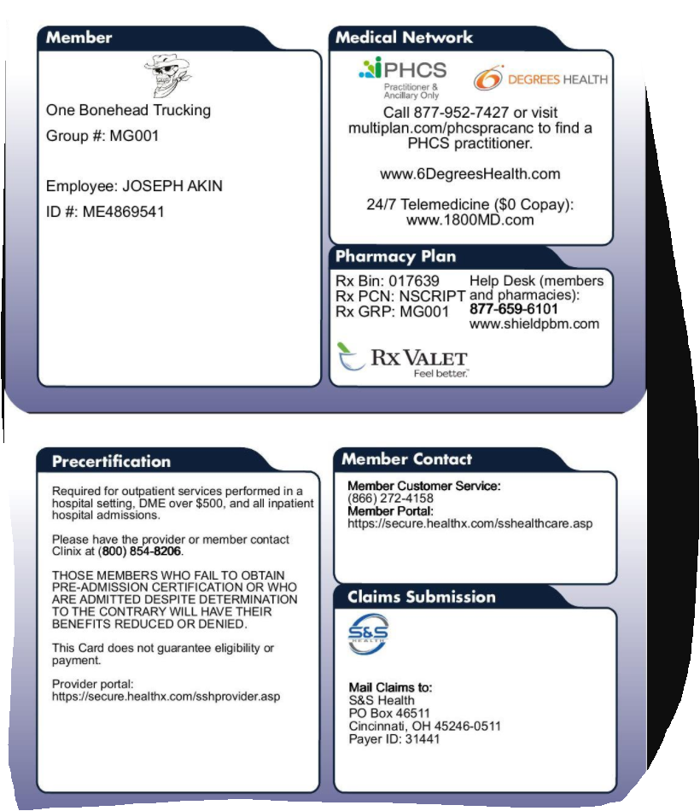
Your benefit card
Your company
Front
John Doe
On the back of your card is all the information your pharmacy, doctor, or hospital will need to access your benefits. Here you will find..
Back

Slide 4
PHCS Private Healthcare Systems
PHCS is a nationally recognized PPO network. The way it works is when you need a primary care physician, specialist, lab work or imaging, all you have to do is verify that they are in the PHCS network.
You can call your provider and ask if they are in the network
You can also go on the website , https://www.multiplan.com/webcenter/portal/ProviderSearch , you will then select PHCS as your network, next, select your practitioner and ancillary.
You can also go to he website nationwideselffunded.com at the top of the page or click resources to access portals
After you’ve made sure your practitioner is in the network, book your appointment and bring your benefit card. The doctor's office will verify your coverage and you will only have to pay your copay and/or deductibles!

Slide 5
RBR Reference based reimbursement provided by 6 degrees
This part of your benefits is used for any hospital, surgical, or other needs outside of your normal doctor’s visits.
When you need to have a procedure done at a hospital or outpatient care facility, you need to get it pre-certified by your Third-Party Administrator. Call the number on the back of your benefits card and talk to your member representative. They will work with you and 6 degrees to set up your appointment
In case of an emergency visit to the hospital, let the Processor know that you have an open access Referenced Based Reimbursement plan. They might say they do not accept that coverage, don’t worry, they do. Have them call the number on the back of your benefit card for confirmation of your benefits.
You are not responsible for a billed amount except copays and deductibles!
If you receive a bill, contact your Third-Party Administrator at the number on the back of your card and they will walk you through how to submit the bill to be repriced and taken care of by your health benefits plan.

Slide 6
RBR Tips and tricks
Never set up a payment plan or payment to the provider
If you are not sure what hospital to go to or want to do research before talking to your member advocate at your TPA you, can use the Medivi system https://medivi.6degreeshealth.com/ to look up cost and quality of care scores for any public hospital in your area. The Medivi program will tell you how much you can save through referenced based reimbursement and which hospitals in your area has the best quality of care score.
Traditional PPO or HMO networks will pay 350% to 450% of Medicare. With 6 Degrees, your Referenced Based Reimbursement provider this charge is typically reduced to 160% to 200% of Medicare. What does this mean to you, the member? 6 Degrees helps keep your benefits costs lower because your expenses are lower which saves you money.
Visit nationwidedselffunded.com and click resources to learn more, or you can go to Medivi

Slide 7
Shield PBM Your prescription drug benefit
To register and order your prescriptions, go to your shield portal on nationwideselffunded.com. Your maintenance prescription drugs will be delivered to your house with a 90-day supply once you submit your prescription to Shield PBM.
Through your Shield portal you can get the medication immediately at your local pharmacy with a prescription from your doctor.
Example- let’s say the prescription you need typically costs your health benefits plan $53. You have a $20 co-pay and the benefit plan pays the other $33. With Shield, they have negotiated that price down to $7. Now all you pay is the $7. You just saved $18 on that prescription!
Shield will automatically deny your claim for a prescription drug with a co-pay of $250 or more, but as they do this they will immediately go to work and will contact you to see if they can get you into a Patient Assistant Program. This program has been able to reduce high prescription co-pays down from $250 to no cost to the member.
Shield saves you time, money, and hassle on getting the prescription drugs that you or your family
Visit nationwidedselffunded.com and click resources to enroll and learn more

Slide 8
1800 MD Your telemedicine benefit
For zero cost to you, you have access 24 hours a day to a telemedicine doctor who can help you with the most common reasons somebody might go to the doctor. Why go to an urgent care when you can call the doctor right from the comfort of your home. Plus, it saves you money! No co-pays and no out of pocket expense to you. 1800 MD can diagnose symptoms and prescribe medication right over the phone and because they are integrated with Shield, they can seamlessly send your prescription to Shield PBM for processing and pickup.
Visit nationwidedselffunded.com and click resources to enroll and learn more

Slide 9
All the tools you’ll need!
Please visit nationwideselffunded.com, click on resources, where you will find portals to each of your access providers which provides you more information about your benefits. There you will also find access to apps that you can download on your phone for information on the go! You must enroll in all these portals
Employer/employee portal- Access digital cards, view Benefit description, and check claims status for any claims you have. You must enroll at nationwideselffunded.com, click resources, find box 04
Shield – portal can be accessed at the shield website, https://www.shieldpbm.com/ . To enroll, visit nationwideselffunded.com, click resources, and find box 03
6 degrees- MediVI portal can be accessed at the 6 degrees website, https://medivi.6degreeshealth.com/ , as well as the 6 degrees “MediVI” app. To enroll, visit nationwideselffunded.com, click resources, and find box 01
1800MD- To enroll, visit nationwideselffunded.com, click resources, and find box 05
PHCS- Portal can be accessed at https://www.multiplan.com/webcenter/portal/ProviderSearch, To enroll, visit nationwideselffunded.com, click resources, and find box 02

Slide 10
In Summary
PHCS is your access for your average doctor's visit, x-ray, or lab work.
RBR is your access for your hospital visits and outpatient surgical procedures.
Shield PBM is access for your prescription drugs.
1800 MD is access for your telemedical appointments.
- Money saved by using these accesses to your medical care not only saves you money at time of care but also saves you money at time of renewal of your coverage.
- We all know for claims that are paid in a year raises your next years benefit cost.
For example, don’t go to an emergency room unless its an actual emergency. Use your primary care physician instead or 1800MD for normal illnesses or injuries.
All links mentioned above can be located at nationwideselffunded.com in the tab “explore benefits”
If you need further assistance understanding your benefits or how to use your benefits properly, please call the third-party administrator at (866)-272-4158

